Slide 1
BÁO CÁO MINI PROJECT MÔN LẬP TRÌNH HƯỚNG ĐỐI TƯỢNG
Nhóm 1 – Topic 2: Demonstration of sorting algorithms on an array (1)
Team members Nguyễn Việt Anh(L)
Nguyễn Bình An
Hoàng Ngọc Ánh
Hoàng Tố An

Slide 2
01. Problem statemen
Arrays are the most basic structure of computer science. Most operations as well as other data structures are built and performed on an array.
In this project, we will show you how the bubble sort, heap sort, and shell sort algorithms work.

Slide 3
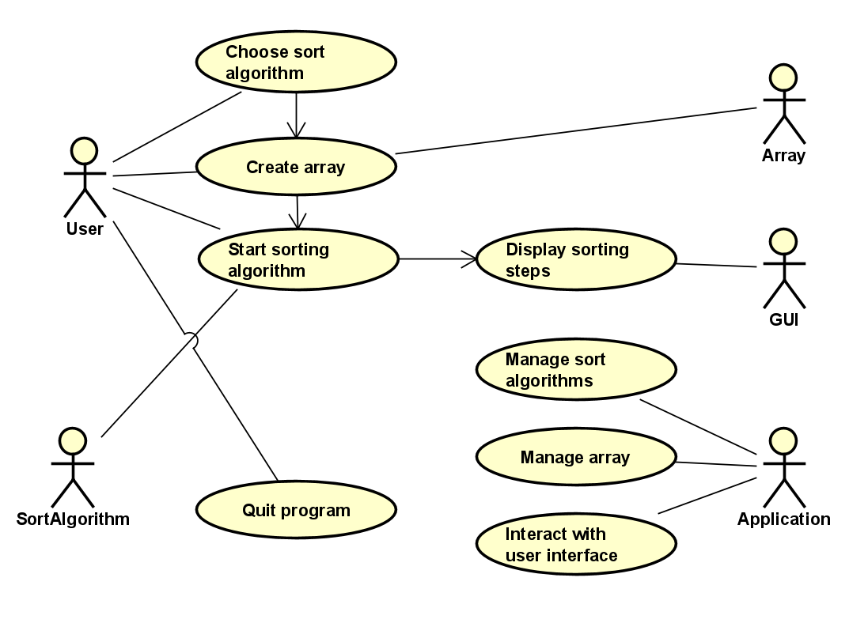
02. Use Case Diagram

Slide 4
03.General Class Diagram

Slide 5
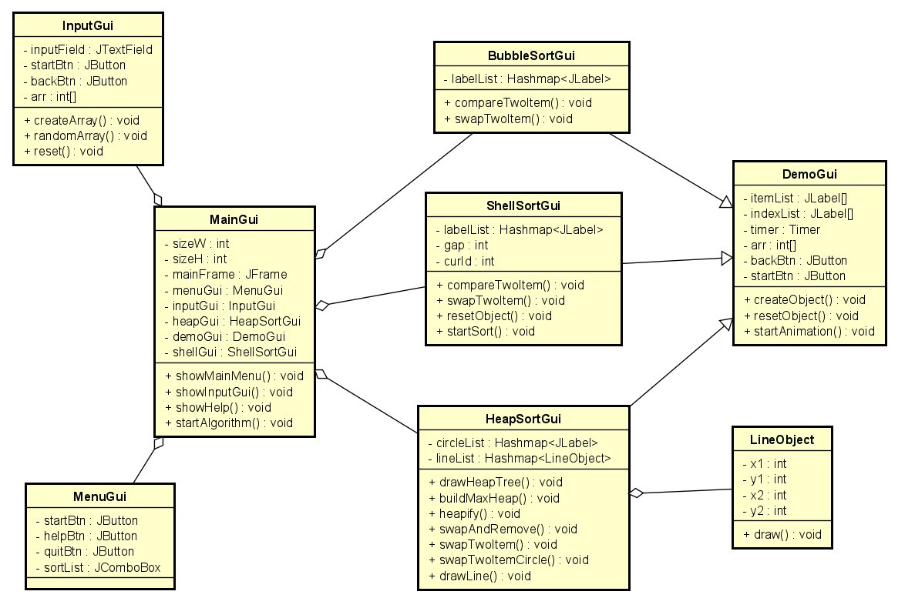
04. Class diagrams for packages/modules

Slide 6
05. Inheritance
BubbleSortGui inhert DemoGui
HeapSortGui inhert DemoGui
ShellSortGui inhert DemoGui

Slide 7
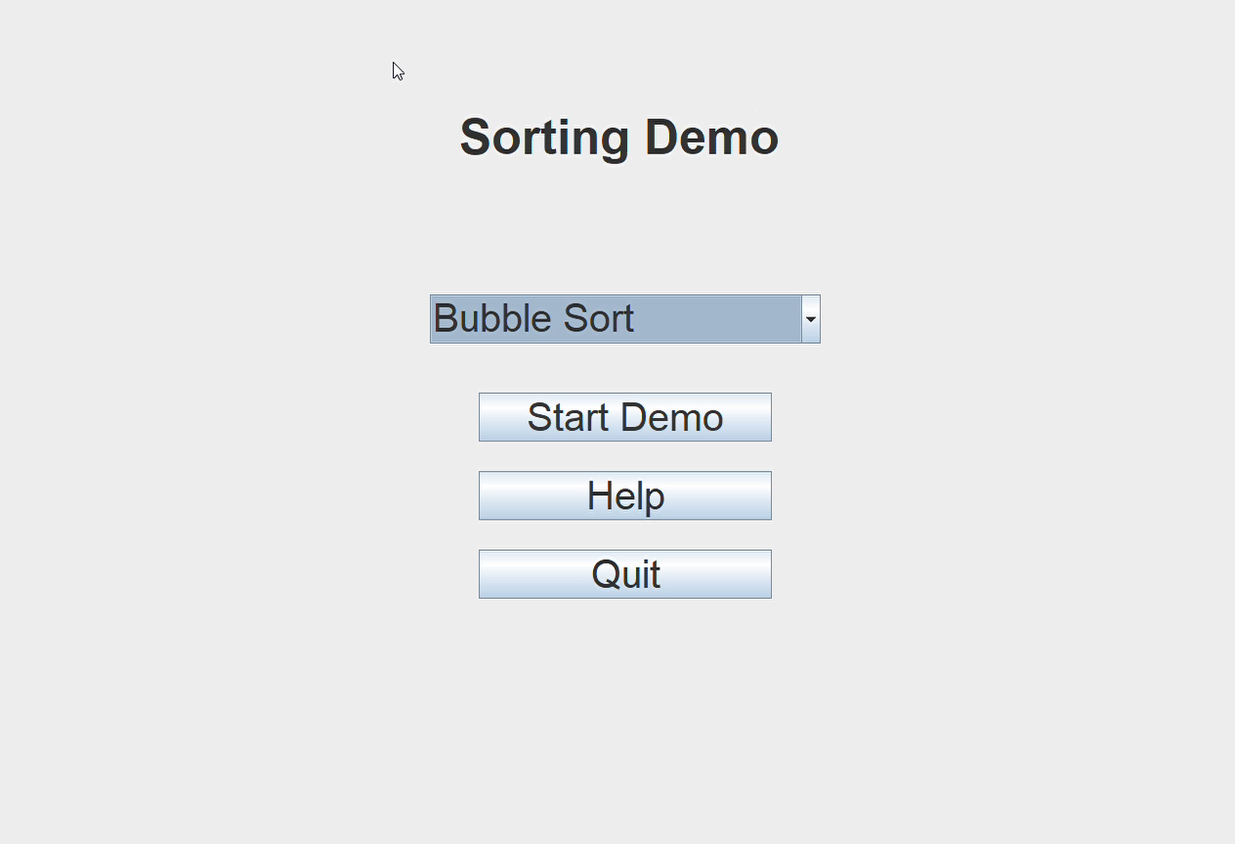
05. Inheritance
Sorting Demo App 2024-01-07 23-12-06.mp4

Slide 8
Thanks!
Do you have any questions?

